Slide 1
Team: NaN Sense
Breast Cancer Classification
A Data Analysis Project Using Logistic Regression
Anthony Nguyen & Steven Marsh

Slide 2
Introduction: The Project Goal
Project Question:
Can we accurately predict if a breast tumor is Benign or Malignant using only cell measurements?
Objective:
To build and interpret a Logistic Regression model to classify tumors from the WDBC dataset.
Dataset:
Wisconsin Diagnostic Breast Cancer (WDBC) - 569 patient samples, 30 quantitative features.

Slide 3

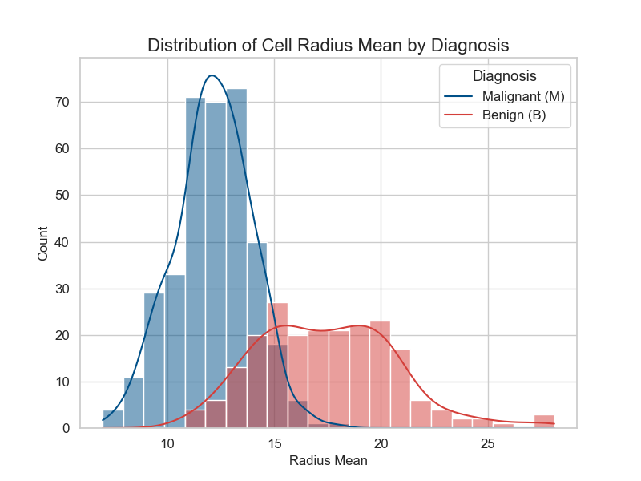
Introduction: The Data
Visualizing The Problem
Before modeling, we can see the data shows a clear separation between classes. This histogram plots the radius_mean feature:
•
Benign (B) tumors cluster with a smaller radius.
•
Malignant (M) tumors (the red curve) show a significantly larger and wider-spread radius.
This visible distinction confirms that our features are highly predictive and that a classification model should be very effective.

Slide 4
2. Analysis Plan & Methodology
2. Split Data
4. Evaluate
Separate data into 70% Training (398) and 30% Testing (171) sets to prevent overfitting.
Test the model on unseen data to generate performance metrics and visualizations.
1. Clean & Prep
3. Train Model
Load wdbc.data.csv, encode target (M/B → 1/0), and apply StandardScaler to all 30 features.
Fit a Logistic Regression model on the training data to learn the feature patterns.

Slide 5
3. Results & Visualizations

Slide 6
Results: Model Performance
97.66%
0.9977
Accuracy on Test Data
Area Under Curve (AUC)

Slide 7
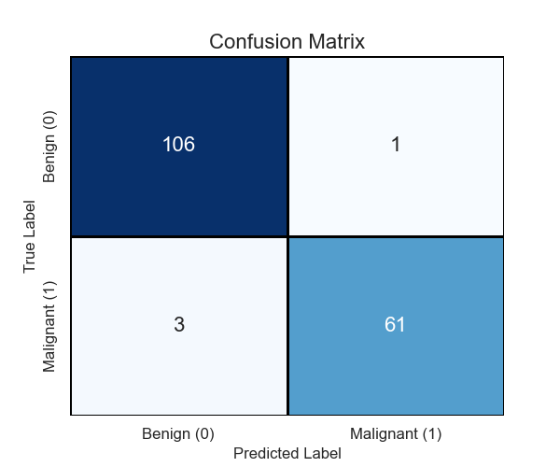
Results: Classification Details
Precision & Recall
The model is highly reliable, with very few errors on the 171 test samples:
•
True Benign (TN): 106
•
False Positive (FP): 1 (Only 1 benign tumor misclassified)
•
False Negative (FN): 3 (Only 3 malignant tumors missed)
•
True Malignant (TP): 61
Malignant Recall: 95.3% (61 / 64)
Malignant Precision: 98.4% (61 / 62)

Slide 8
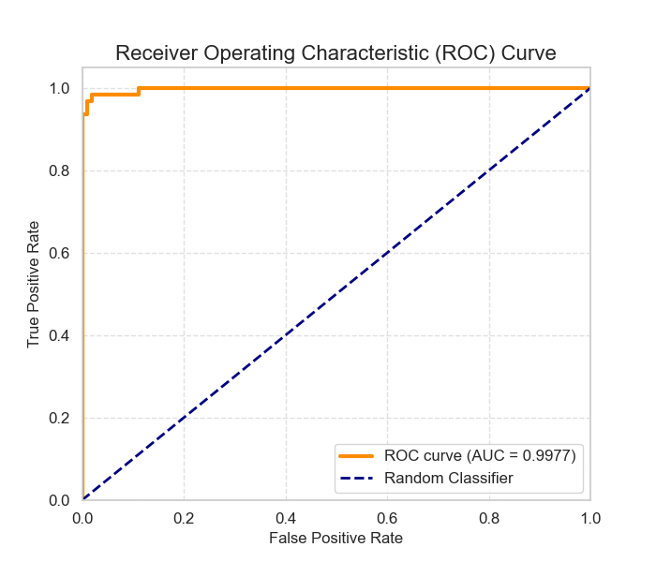
Results: Model Robustness (ROC Curve)
Area Under the Curve (AUC)
The model achieves an AUC of 0.9977.
A score this close to 1.0 indicates a near-perfect ability to distinguish between Benign and Malignant cases across all possible decision thresholds, confirming its high reliability for medical diagnosis.

Slide 9
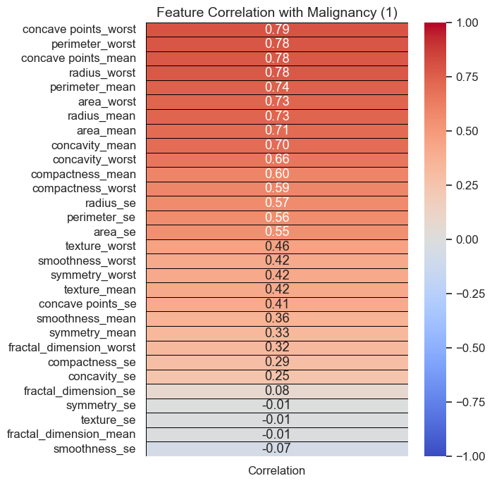
Results: Why Does it Work? (Correlation)
Feature Correlation
This heatmap ranks all 30 features by their linear relationship to a Malignant diagnosis (value of 1).
Key Insight
Features related to size and irregularity (e.g., concave points_worst, perimeter_worst) show the strongest positive correlation (dark red), increasing the likelihood of malignancy.
Features like smoothness_se show almost no correlation (white/blue).

Slide 10
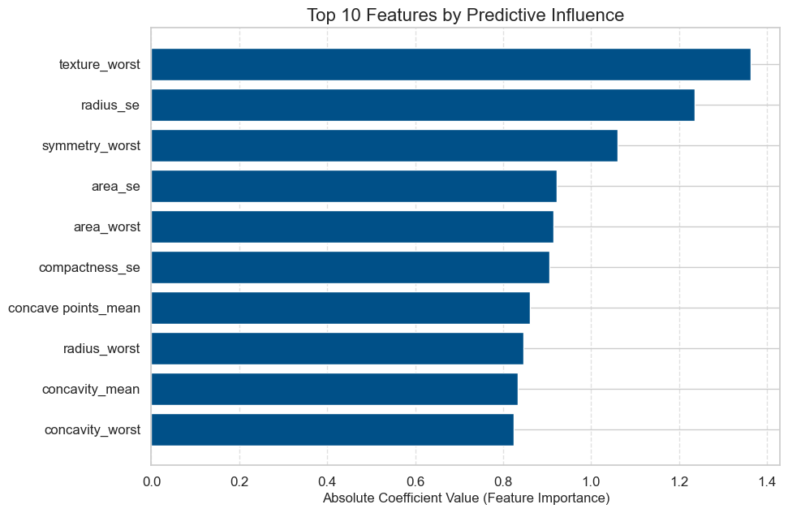
Results: Top Predictive Features
Model Coefficients
This chart shows the "weight" or "influence" the Logistic Regression model assigned to each feature. The larger the bar, the greater its impact on the prediction.
Top 5 Predictors
The model's decision is most influenced by the "worst" (most extreme) measurements and the "se" (standard error) of features:
•
texture_worst
•
radius_se
•
symmetry_worst
•
area_se
•
area_worst

Slide 11
4. Conclusion & Reflection

Slide 12





Final Summary
Question Answered
Key Insight
Learning Impact
Yes, a tumor diagnosis can be accurately predicted (97.66% Acc, 0.9977 AUC) using only its cell nuclei measurements.
The worst-case texture, along with size variability (se) and irregularity (worst), are the most dominant predictive factors.
This project demonstrates the complete analysis pipeline, from data cleaning and scaling (StandardScaler) to building and interpreting an explainable model.

Slide 13
Future Work
Try Other Models: Compare Logistic Regression against non-linear models like a Random Forest or Support Vector Machine (SVM) to see if accuracy can be improved.
Feature Reduction: Use a technique like RFE (Recursive Feature Elimination) to build a simpler, faster model using only the top 5-10 features.
Hyperparameter Tuning: Use GridSearchCV to find the optimal C parameter (regularization strength) for the Logistic Regression model to maximize performance.

Slide 14
Thank You
Questions?

